Slide 1
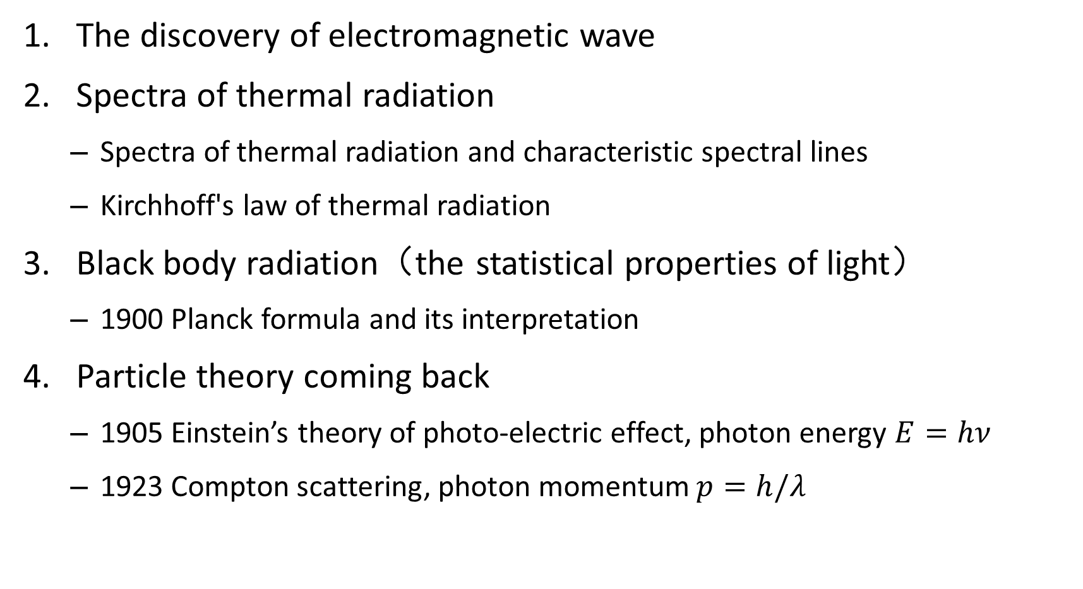
The Nature of light
The discovery of electromagnetic wave
Spectra of thermal radiation
  Spectra of thermal radiation and characteristic spectral lines
  Kirchhoff's law of thermal radiation
Black body radiation（the statistical properties of light）
  1900 Planck formula and its interpretation
Particle theory coming back
  1905 Einstein’s theory of photo-electric effect, photon energy $E=hν$
  1923 Compton scattering, photon momentum $p=h/λ$
Notes:
这一章我们要讨论一个重要的问题，即光的本质。
我们将分四个小节，分别对应于人类在对光的认识过程中的四个重要阶段
1. 光的波粒之争，以及波动说的建立。
2. 光和物质的相互作用，光是怎么来的，以及黑体辐射问题是怎么提出的。
3. 我们将详细讨论黑体辐射问题，普朗克的黑体辐射公式以及解释
4. 粒子的回归：我们将讨论光子的提出和光粒子性的重要证据。

Slide 2
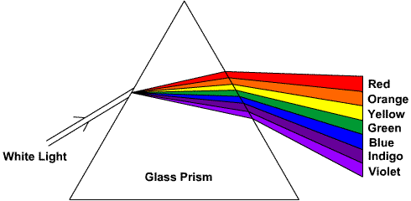
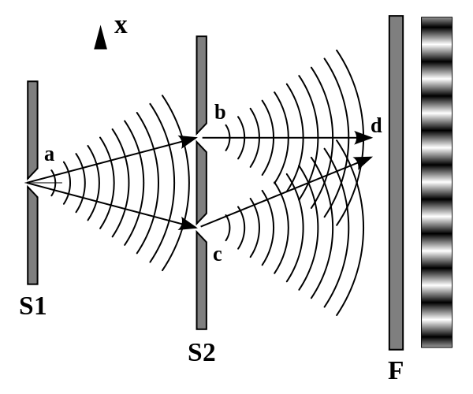
The establishment of the wave theory of light
1670s: earlier debate
  Huygens, Hooke：Wave in ether
  Newton: corpuscles
The triumph of wave theory
  Young’s double slit （1801）
  Fresnel’s explanation of refraction（1815）
  1860s Maxwell’s equations predicted EM waves and light
  1887 Hertz’s experimental demonstration of EM waves
  Lorentz oscillator model
Notes:
Wave theory explains reflection, refraction, and interference phenomena
1887年被赫兹在实验室里产生了无线电波，证实了Maxwell的预言。Maxwell发现电磁波在真空中的传播速度和当时测到的光速值相等，因而推断光就是电磁波。
利用电磁波理论可以解释光的反射，折射，干涉等重要性质。

Slide 3
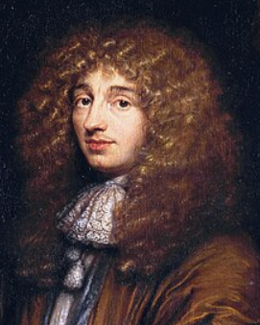
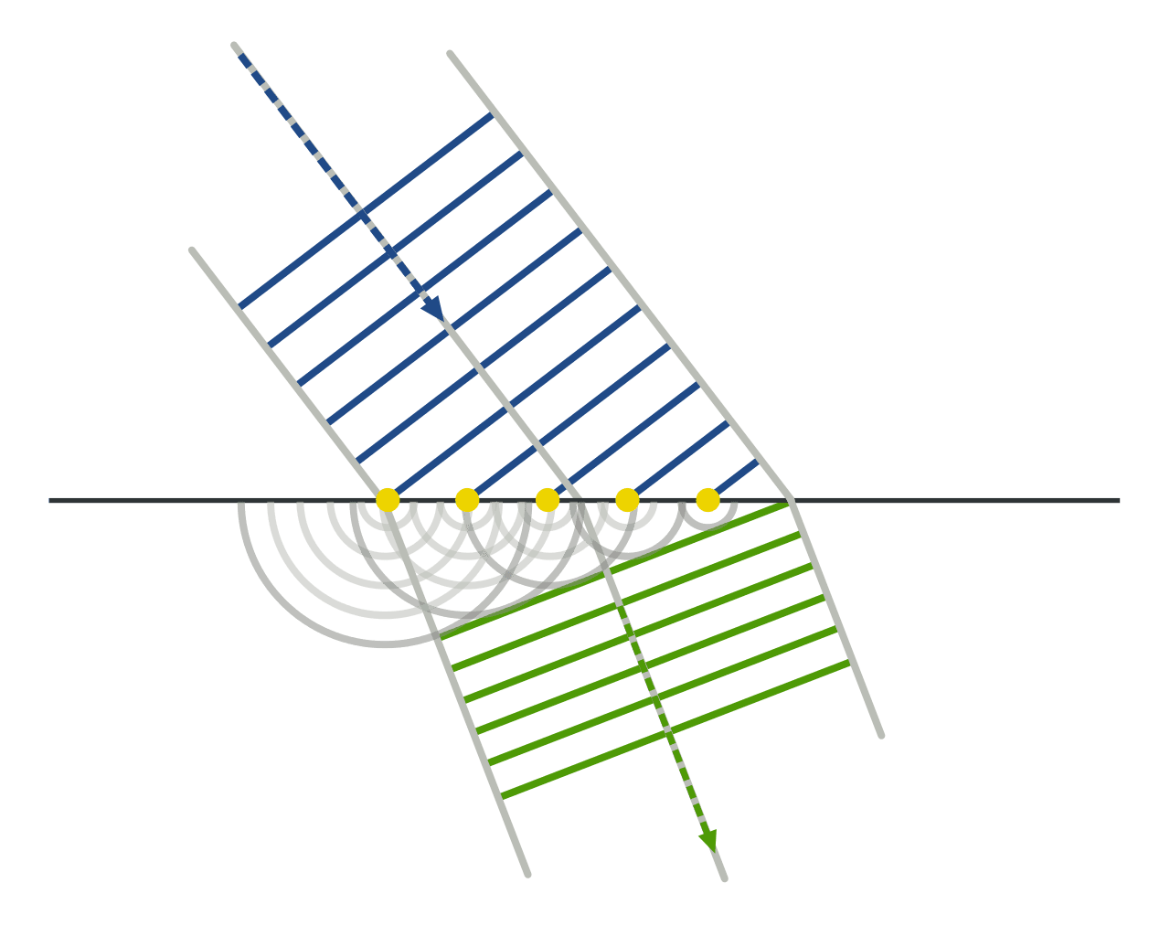
Huygens’s principle
  Every point on a wavefront acts as a source of secondary spherical wavelets that spread out in the forward direction at the same speed as the wave itself.
  The new wavefront is the tangent surface to all these secondary wavelets at a later time.
  light slows down in denser medium (e.g., glass or water) .
Christiaan Huygens
Treatise on light (1690)

Slide 4
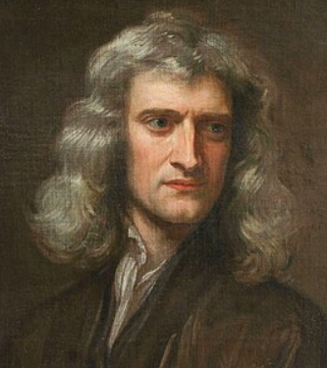
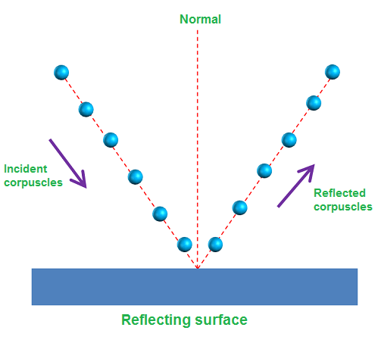
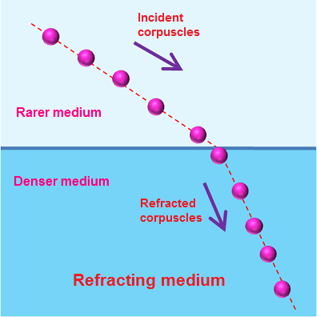
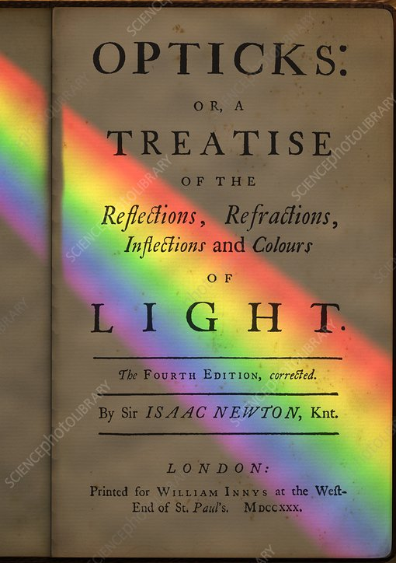
Newton’s corpuscle theory
  Light comprises tiny particles called ‘corpuscles’ having negligible mass.
  These corpuscles are perfectly elastic
  Light corpuscles travel faster in denser media than in less dense media
  When light corpuscles enter a denser medium, they experience an attractive force perpendicular to the surface of the medium
Isaac Newton
Opticks (1704)

Slide 5
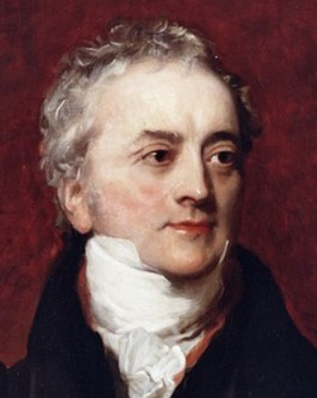
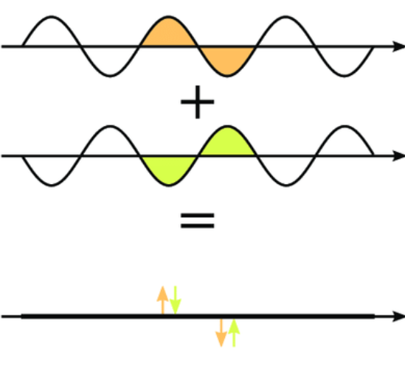
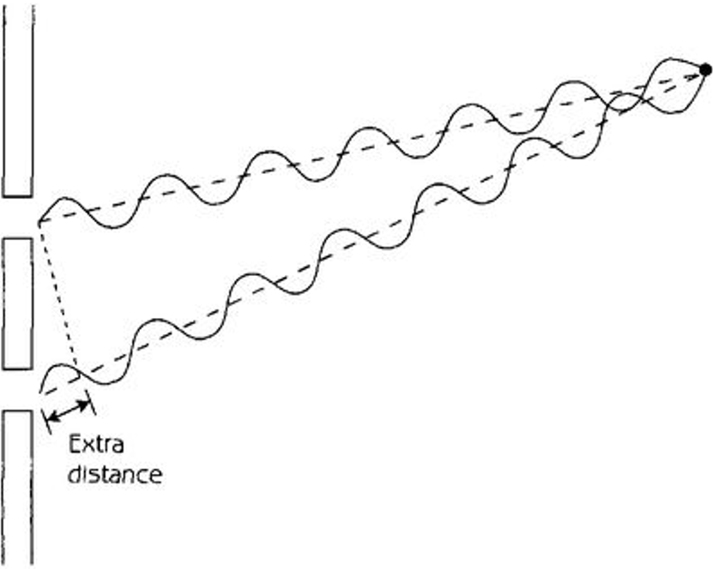

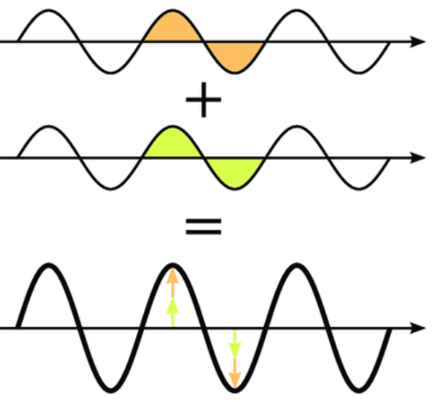
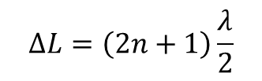


托马斯·杨 双缝干涉 （1801）
Young’s double slit interference experiment (1801)
  Young’s principle of interference: when two or more waves overlap, their displacements add together (superposition principle).
$$ΔL=\left(2n+1\right)\frac{λ}{2}$$
Thomas Young
$$ΔL=nλ$$
$$ΔL$$
Notes:
两列波同时到达目的地，但由于它们走的路程长度不同，它们速度又是相同。因此，它们在从B和C点的出发的时间一定是不同的。因此不一定同步，相位不同。

Slide 6
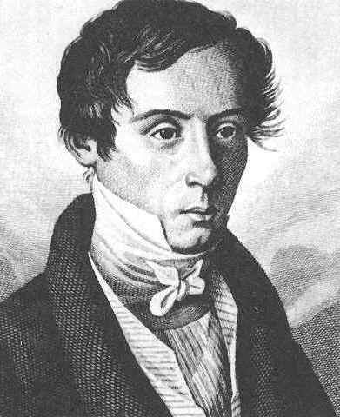
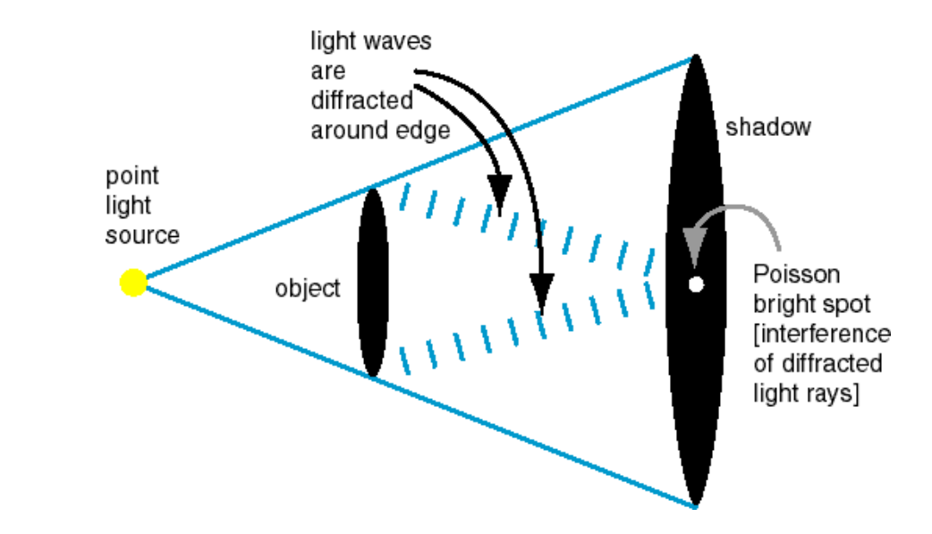
Fresnel’s wave theory（1815）
Combing Huygens' principle, Young’s principle of interference, and transverse polarizations hypothesis. Fresnel laid the foundation of the wave theory of light.
His paper on the study of diffractions using the wave theory won the 1st prize in the 1818 optics competition held by the French Academy of Sciences.
Poisson derived an absurd result from Fresnel’s theory, indicating it might be wrong.
Poisson spot or Arago spot
Arago’s verification
Notes:
Among the jury, Biot, Laplace and Poisson are the most resolutely opposed to wave theory. Poisson in particular, fascinated by Fresnel’s theory, studies it in detail, looking for weaknesses. From it he derives a counter intuitive result beyond Fresnel’s own predictions: by placing a disc at a certain distance between a source of light and a screen, a bright spot should appear in the center of the disc’s shadow. To Poisson, this apparently absurd consequence is a proof that invalidates Fresnel’s work.
François Arago experimentally confirmed the existence of this diffraction pattern.
Arago later noted^{[15]} that the phenomenon (later known as "Poisson's spot" or the "spot of Arago") had already been observed by Delisle^{[16]} and Maraldi^{[17]} a century earlier.

Slide 7
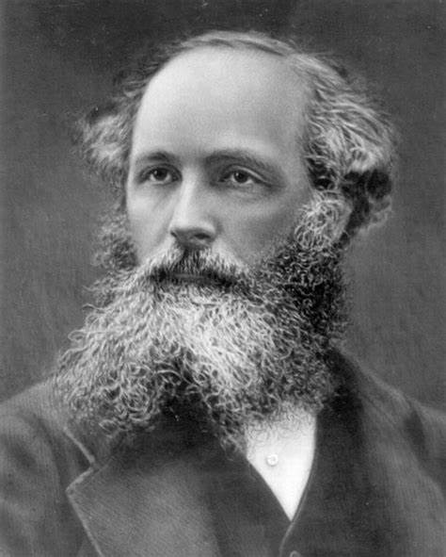
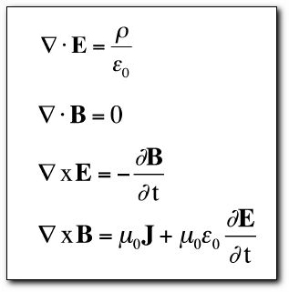
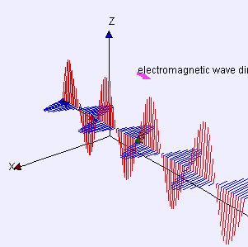
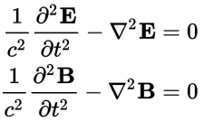
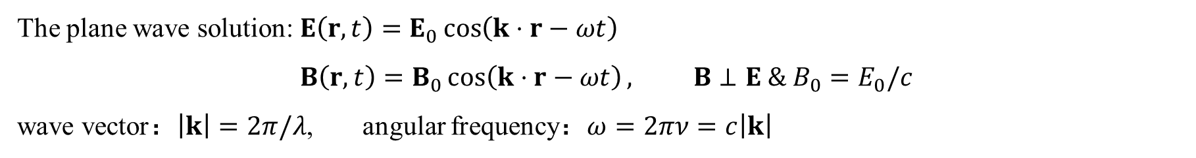
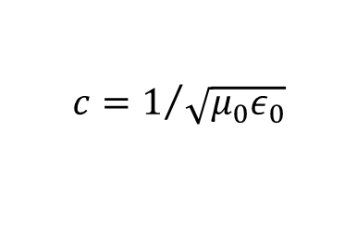

Maxwell’s equations and prediction of electromagnetic waves (1860s)
The solution of Maxwell’s equations: EM Waves
James Clerk Maxwell
$$c=1/{\sqrt{μ_{0}ε_{0}}}$$
E: electric field, B: magnetic field
$$=speed of light$$
The plane wave solution: $E\left(r, t\right)=E_{0}\cos\left(k⋅r−ωt\right)$
$$B\left(r, t\right)=B_{0}\cos\left(k⋅r−ωt\right), B⊥E \& B_{0}=E_{0}/c$$
wave vector：$\left|k\right|=2π/λ$, angular frequency：$ω=2πν=c\left|k\right|$
Notes:
有方程就要有解，一个如何在时空中变化的电磁场，才能满足这个方程组。
这个解是一个典型的横波
光就是电磁场的振动的传播，

Slide 8
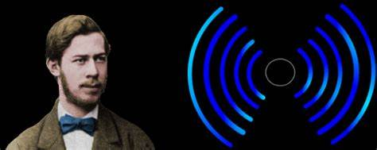
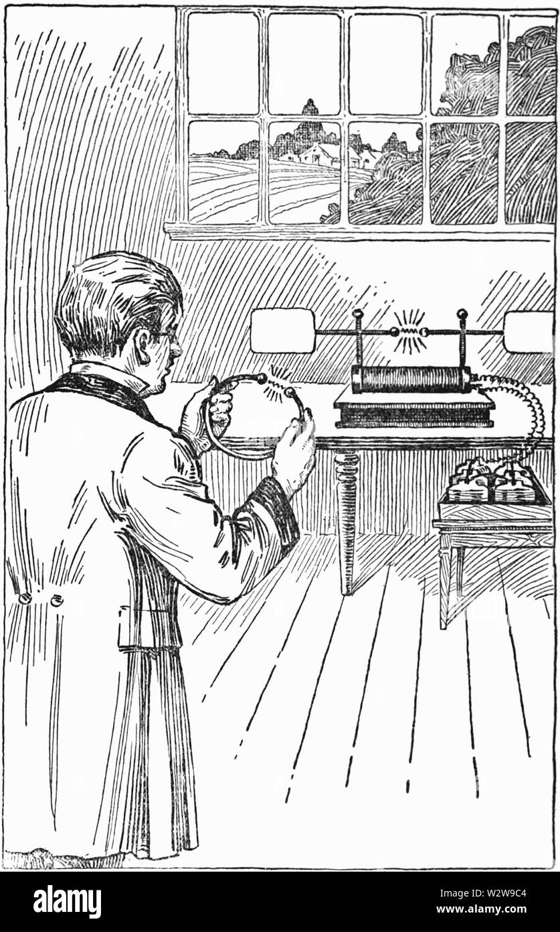
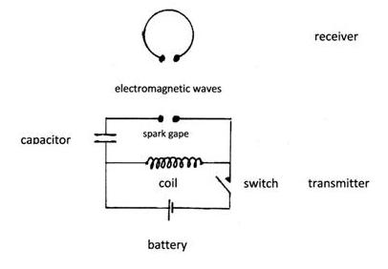
Hertz’s discovery of the radio wave (1886)

Slide 9
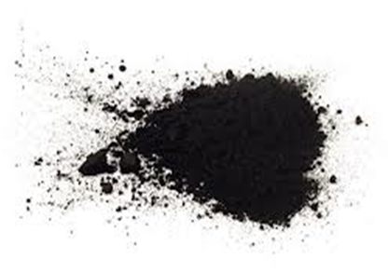
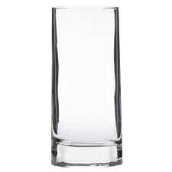
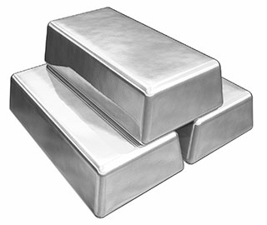
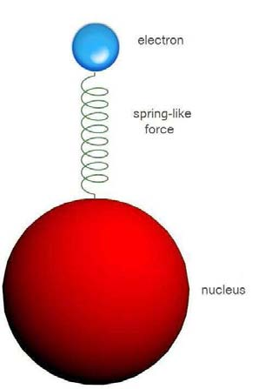
Lorentz oscillator model on the atom-light interaction
Reflection
Transmission
Absorption
Free electron
dipole oscillator
Strongly damped oscillator
Notes:
对可见光而言。

Slide 10
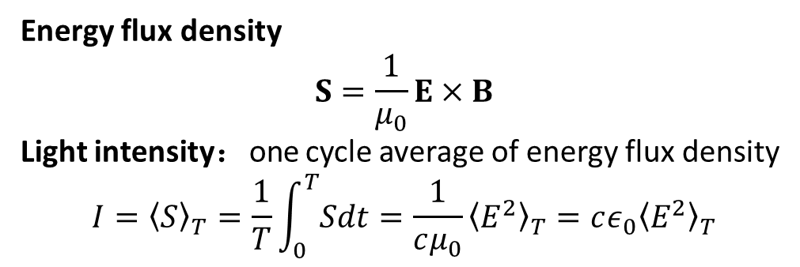
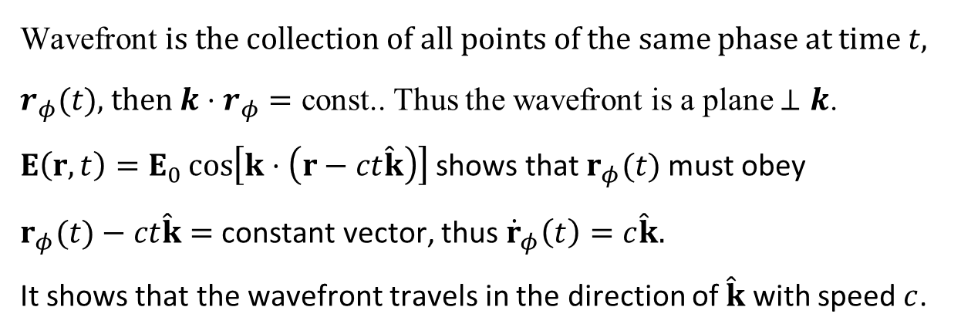
Propagation properties of plane waves
$E\left(r, t\right)=E_{0}\cos\left(k⋅r−ωt\right)$， the argument of $cos$ is the phase, $k$ is wave vector, $\left|k\right|=\frac{ω}{c}$
Wavefront is the collection of all points of the same phase at time $t$, $r_{φ}(t)$, then $k⋅r_{φ}=$ const.. Thus the wavefront is a plane $⊥$ $k$.
$E\left(r, t\right)=E_{0}\cos\left[k⋅\left(r−ct\hat{k}\right)\right]$ shows that $r_{φ}(t)$must obey
$r_{φ}(t)−ct\hat{k}=$ constant vector, thus ${\dot{r}}_{φ}\left(t\right)=c\hat{k}.$
It shows that the wavefront travels in the direction of $\hat{k}$ with speed $c$.
Energy flux density
$$S=\frac{1}{μ_{0}}E×B$$
Light intensity：one cycle average of energy flux density
$$I={\left\langle S\right\rangle }_{T}=\frac{1}{T}\int_{0}^{T}{Sdt}=\frac{1}{cμ_{0}}{\left\langle E^{2}\right\rangle }_{T}=cε_{0}{\left\langle E^{2}\right\rangle }_{T}$$
Hecht, Optics, 4ed

Slide 11
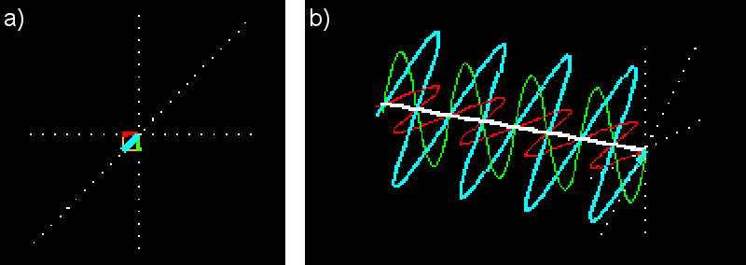
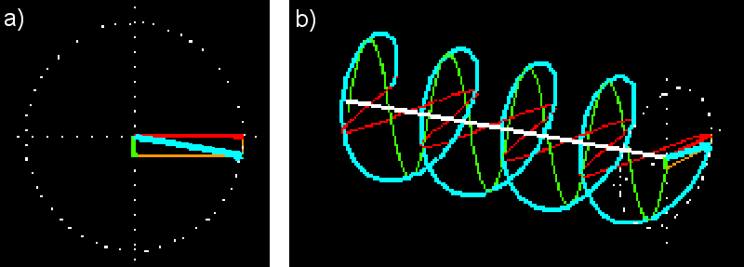
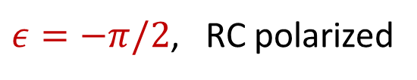

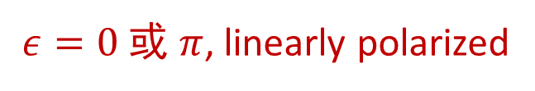

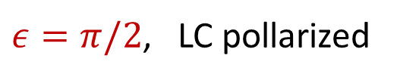
Orthogonal(perpendicular) linear polarization decomposition
$ε=0$ 或 $π$, linearly polarized
$ε=−π/2$, RC polarized
$$E_{R}$$
$ε=π/2$, LC pollarized
$$E_{L}$$
Notes:
所有偏振都可以分解成两种基本偏振的叠加。差别在用两种基本偏振振幅之比和位相之差。

Slide 12
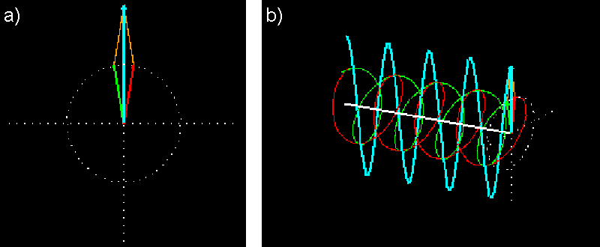
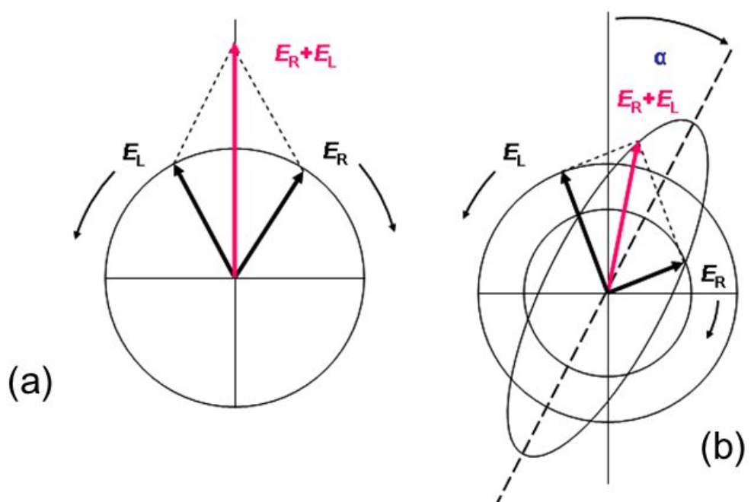
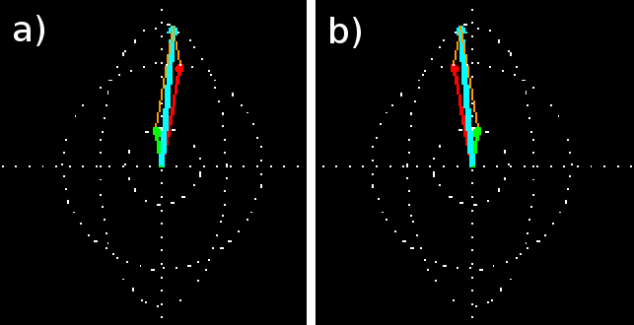
Orthogonal(perpendicular) circular polarization decomposition

Slide 13

Polarizer filters the polarization
$I\left(θ\right)=$ $I_{0}\cos^{2}{θ}$
Hecht, Optics, 4ed

Slide 14
Half wave plate
Wave plate transforms the polarization
Fast axis
Fast axis
quarter wave plate
Fast axis
Fast axis
Hecht, Optics, 4ed
Notes:
线双折射晶体

Slide 15
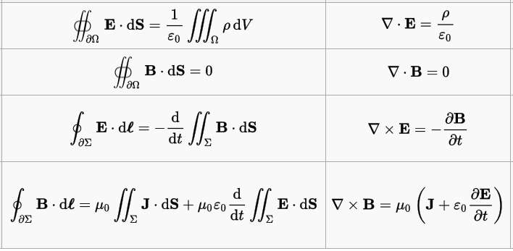
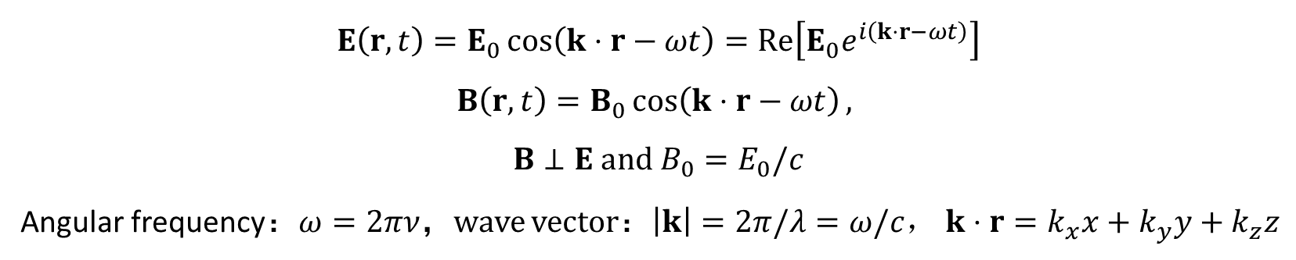
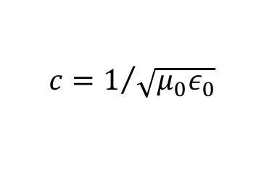
Maxwell’s 方程组和电磁波
Integral form
Differential form
Gauss’s Law
Wave equation
Gauss’s law for magnetism
Faraday’s law
Ampere’s law +
displacement current
$$c=1/{\sqrt{μ_{0}ε_{0}}}$$
The plane wave solution:
$$E\left(r, t\right)=E_{0}\cos\left(k⋅r−ωt\right)=Re\left[E_{0}e^{i\left(k⋅r−ωt\right)}\right]$$
$$B\left(r, t\right)=B_{0}\cos\left(k⋅r−ωt\right),$$
$$B⊥E and B_{0}=E_{0}/c$$
Angular frequency：$ω=2πν$，wave vector：$\left|k\right|=2π/λ=ω/c$， $k⋅r=k_{x}x+k_{y}y+k_{z}z$

Slide 16
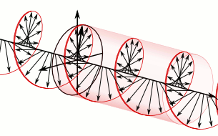








Polarization properties of Plane waves
$$E\left(r, t\right)=E_{0}\cos\left(k⋅r−ωt\right)$$
Linearly polarized light
Circularly polarized light
$$x$$
$$E$$
$$x$$
波矢 $k$
$$y$$
$$y$$
$$B$$

